Slide 1
Cryptography and System Security
Mini Project on:
GUI Based Encryption and Decryption using Vigenere Cipher Technique

Slide 2
Project By:
Name: Nehal Rajesh Pawar
Roll No: 258
PRN No: 0120180421
Seat No: T218407
Brach: TY Btech (IT)

Slide 3
Table of Contents
Introduction
Objectives: Cryptography
Main Components – Cryptography
Encryption and Decryption
Vigenere Cipher Technique
GUI and Project Description
GUI Interface

Slide 4
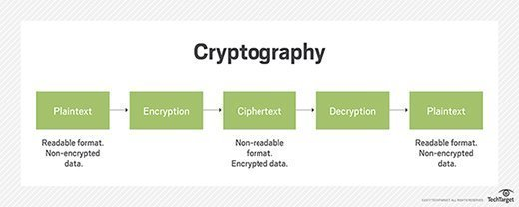
Introduction: Cryptography
Cryptography is a method of protecting information and communications through the use of codes, so that only those for whom the information is intended can read and process it.
In computer science, cryptography refers to secure information and communication techniques derived from mathematical concepts and a set of rule-based calculations called algorithms, to transform messages in ways that are hard to decipher.

Slide 5
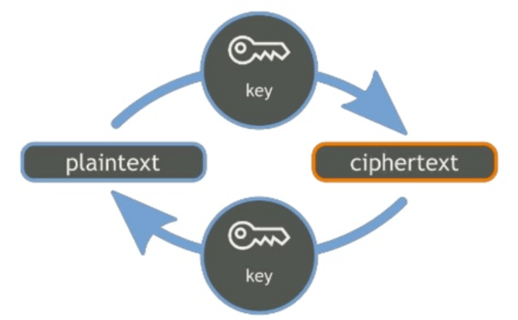
Cryptography:

Slide 6
Cryptography: Objectives
Modern cryptography concerns itself with the following four objectives:
Confidentiality: The information cannot be understood by anyone for whom it was unintended.
Integrity: The information cannot be altered in storage or transit between sender and intended receiver without the alteration being detected.
Non-repudiation: The creator/sender of the information cannot deny at a later stage their intentions in the creation or transmission of the information.
Authentication: The sender and receiver can confirm each other's identity and the origin/destination of the information.

Slide 7
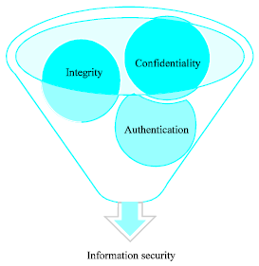
Main Components

Slide 8
Encryption & Decryption
Encryption is a means of securing digital data using one or more mathematical techniques, along with a password or "key" used to decrypt the information. The encryption process translates information using an algorithm that makes the original information unreadable.
The conversion of encrypted data into its original form is called Decryption. It is generally a reverse process of encryption. It decodes the encrypted information so that an authorized user can only decrypt the data because decryption requires a secret key or password.

Slide 9
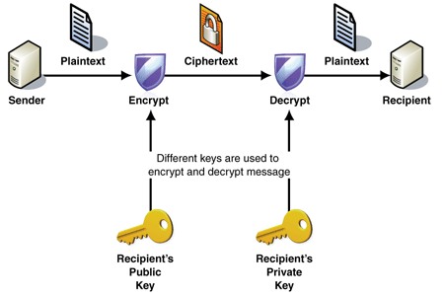

Slide 10
Vigenere Cipher Technique
The Vigenère cipher uses a 26×26 table with A to Z as the row heading and column heading This table is usually referred to as the Vigenère Tableau, Vigenère Table or Vigenère Square. We shall use Vigenère Table. The first row of this table has the 26 English letters. Starting with the second row, each row has the letters shifted to the left one position in a cyclic way. For example, when B is shifted to the first position on the second row, the letter A moves to the end.

Slide 11
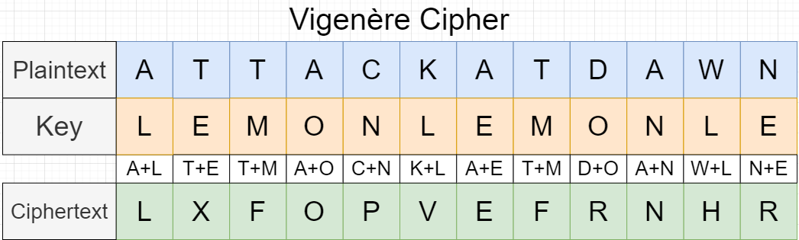

Slide 12
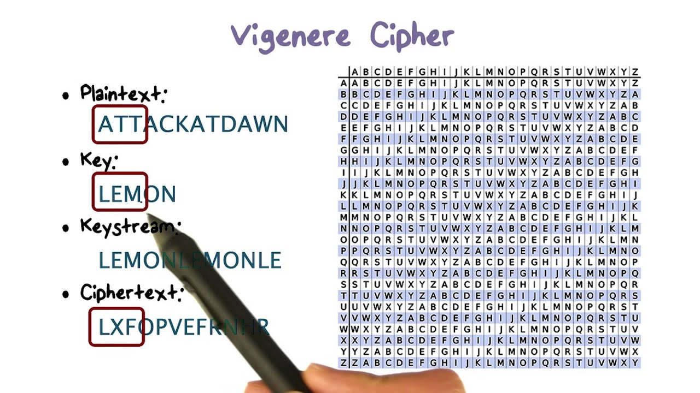
Vigenere Cipher: continued

Slide 13
GUI Based Encryption and Decryption:
In this project we have used the same concept of encryption and decryption of text message using vigenere cipher.
In this Project GUI based Execution of the project is done by using python language.
Here we have asked to input a text message to be encrypted or decrypted using Caesar cipher and we get output as encrypted message or decrypted message.
It allows us to encrypt or decrypt message using any encryption and decryption techniques, here we are majorly dealing with Vigenere Cipher.

Slide 14
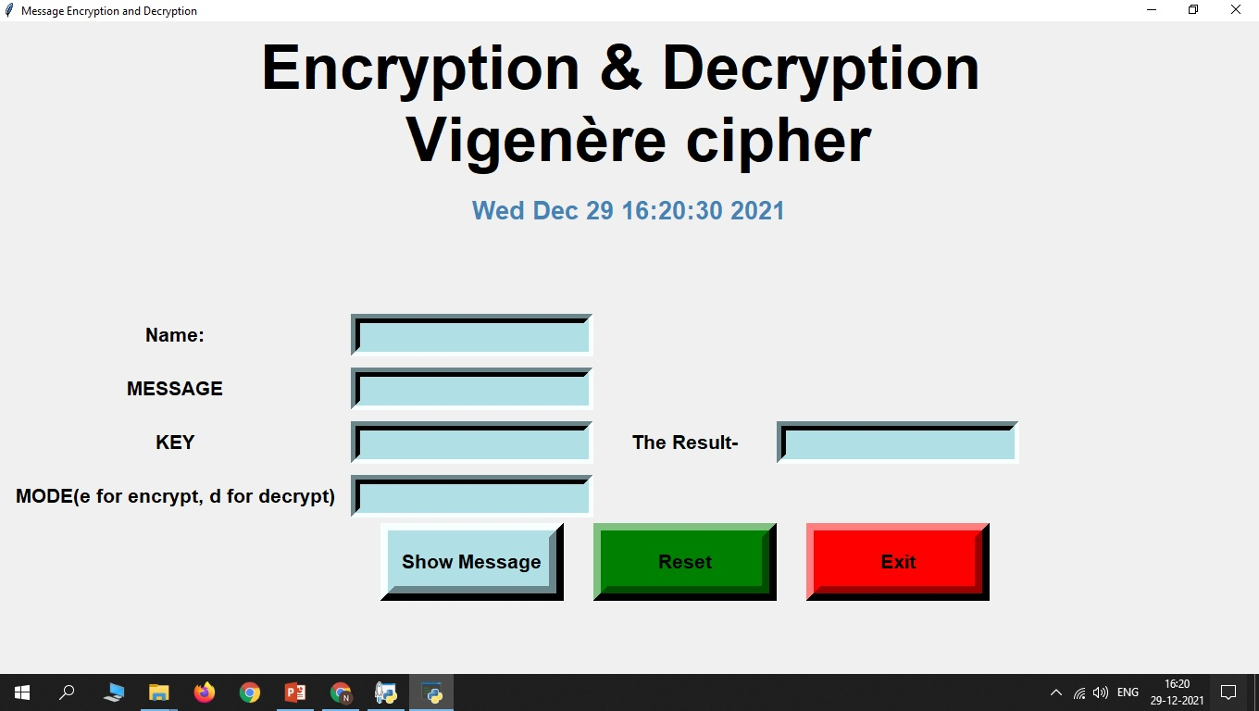
GUI Interface: Main

Slide 15
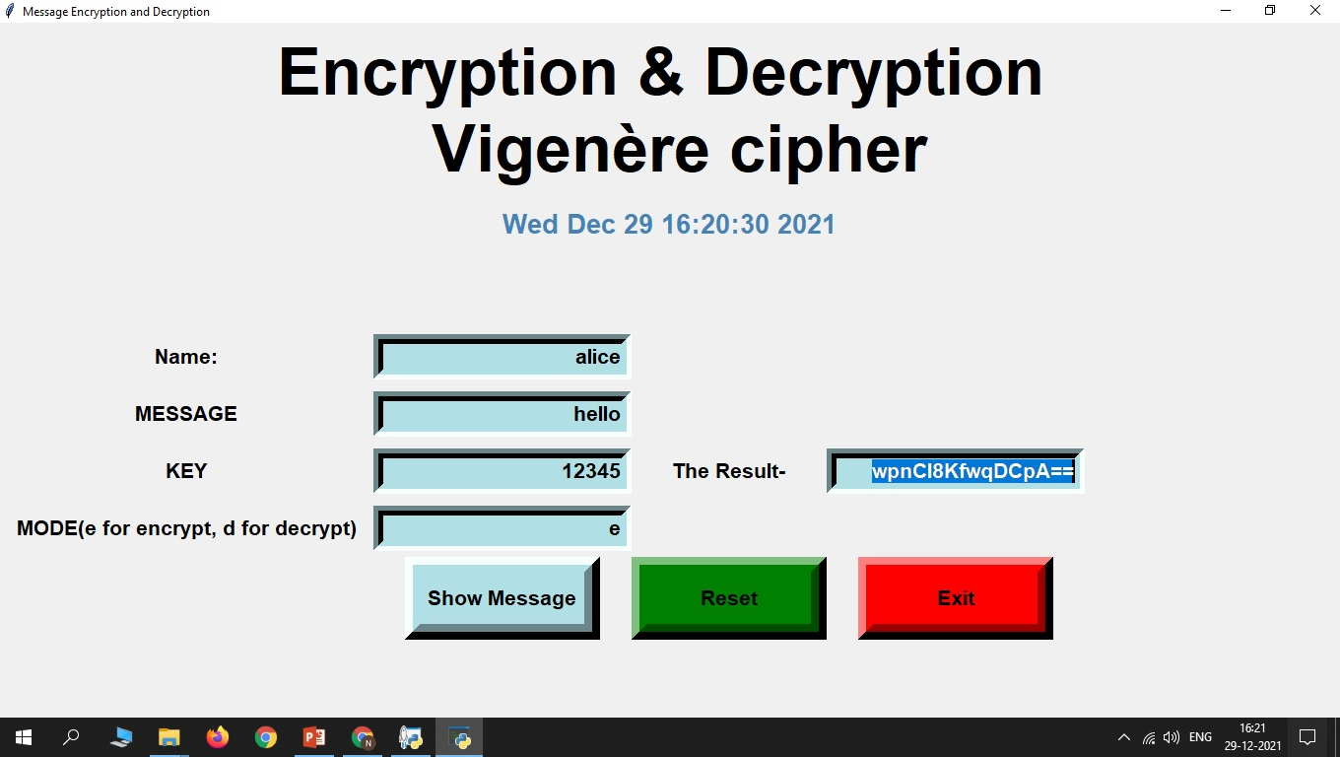
GUI Interface: Encryption

Slide 16
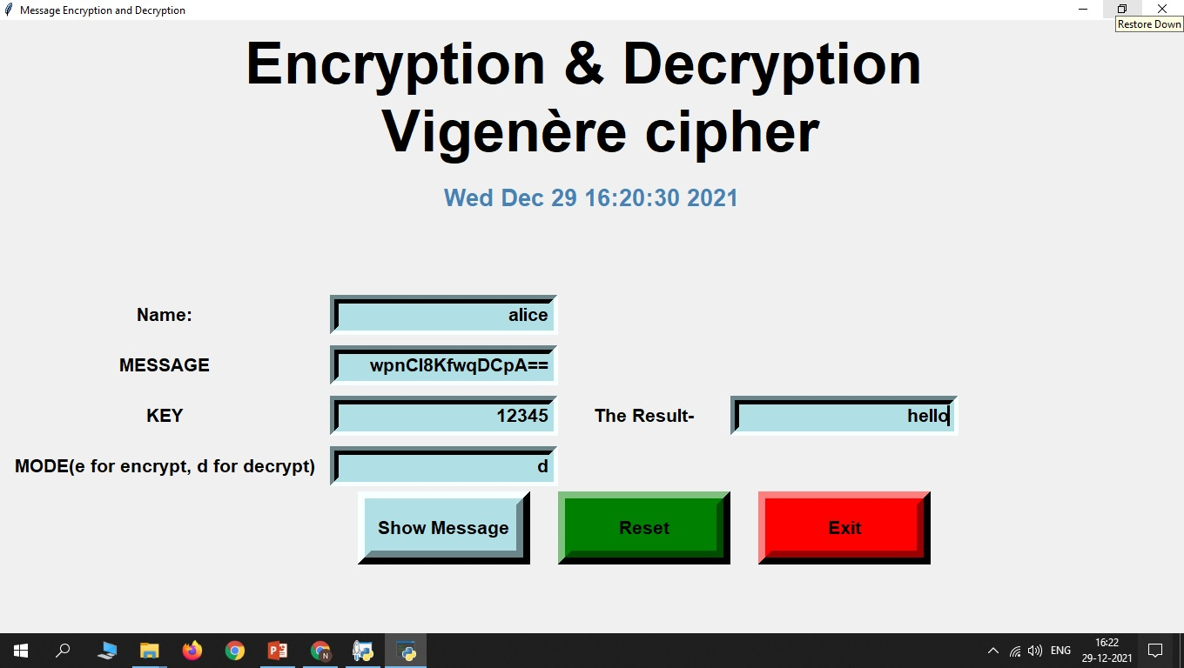
GUI Interface: Decryption

Slide 17
Thank You!!

